Slide 1
Software Testing Methodologies
Prashant Joshi

Slide 2
Module 13: Agenda
Topic 13.0
Life Cycle – Perspectives & Focus
Topic 13.1
Life-Cycle Based Testing – Overview & Perspective
Topic 13.2
Life-Cycles – Waterfall, Iterative & Agile
Topic 13.3
Implications and Issues, Strategies & models
Topic 13.4
Example and Case

Slide 3
Topic 13.0 Perspectives & Focus

Slide 4
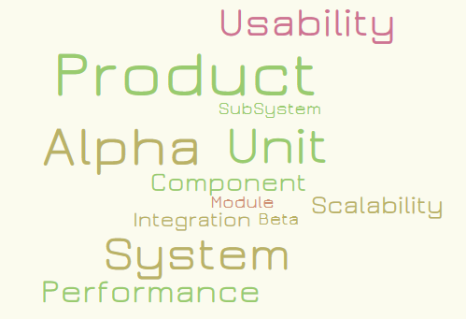
Life-Cycle & Model View
Software Development Life Cycles
Model Based Testing
Testing at all levels

Slide 5
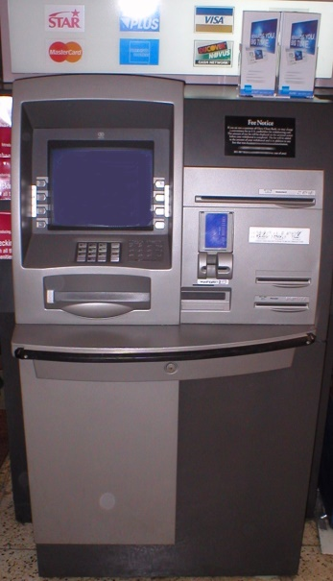
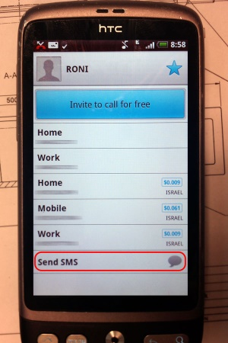
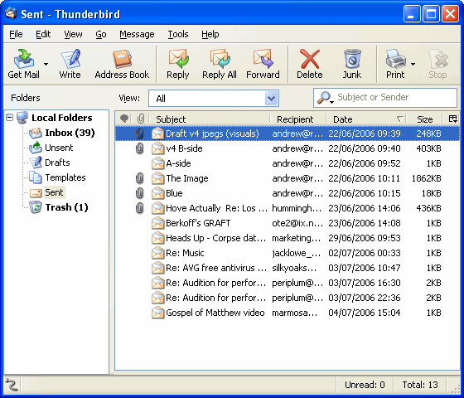
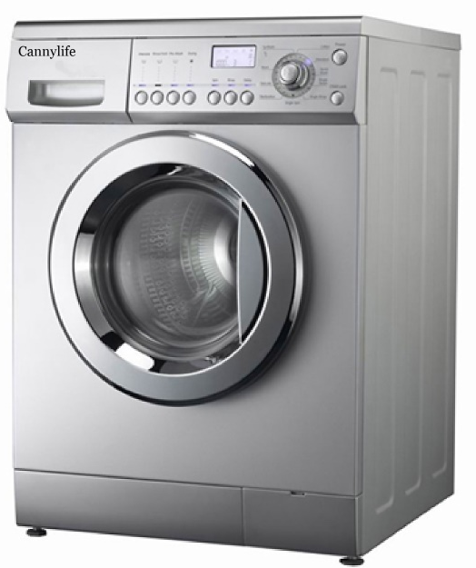
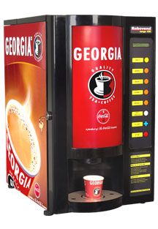
Review & Remember
Levels of Testing
Targets
Unit
Integration
System
Objectives
Acceptance
Installation
Conformance
Functional
Correctness
Regression
Performance
Stress
…
Ref: SWEBOK 2004

Slide 6
Review & Remember
Test Techniques (Our course, Our Focus)
Specification-based
Code-based
Based on Nature of Application
OO testing
GUI
…
Selecting and Combining Techniques
Functional and structural
Deterministic vs. Random
Ref: SWEBOK 2004

Slide 7
Review & Remember
Test Related Measures
Evaluation of Program under test
Evaluation of the Tests Performed
Test Process
Practical Considerations
Test Activities
Ref: SWEBOK 2004

Slide 8
Software Testing Methodologies
Prashant Joshi

Slide 9
Topic 13.1: Life-Cycle Based Testing – Overview & Perspective

Slide 10
Building Blocks – A View
SW Products
SW Test Tools
Test Research
Test Techniques Application
Functional, Behavioral, IOT, Usability, Integration, Unit, Performance, Stress
Test Techniques Development
EC, BVA, DT, CEG, McCabe, OATS, Data Flow, Control Flow
Math
Set theory
Discrete
Combinatorial
Concepts
SW Arch, Design, Data Structures
Problem
Code coverage
Quality
Zero Defects

Slide 11
Progression
…
EC/BVA
Product
Testing
Test
Reports
Concepts
CEG/DT
Math
OATS
Testing
Tools
Data/Control
Flow
Problem
Auto
Execution
Usability
Test
Automation
Auto
Generation
Exploratory

Slide 12
Test Process – Test Activities
Test Planning
Test case generation
Test environment development
Test Execution
Test results evaluation
Problem reporting/Test log
Defect tracking

Slide 13
Software Development Life Cycles
Life Cycle Models
Waterfall
V-model
Prototyping
Waterfall – spin-offs
Evolutionary
Incremental Model
Spiral

Slide 14
The V Model
Requirements Specifications
System testing
Preliminary Design
Integration Testing
Detailed
Design
Unit
testing
Coding
Please refer to the paper on the taxila

Slide 15
Focus Areas
People
Process
Product
Technology
Research
Business
Innovation
Engineering

Slide 16
Software Testing Methodologies
Prashant Joshi

Slide 17
Topic 13.2 : Life-Cycles – Waterfall, Iterative & Agile

Slide 18
The Waterfall
Requirements Specifications
Preliminary Design
Detailed
Design
Coding
Unit
testing
Integration Testing
System testing

Slide 19
The V-Model
Requirements Specifications
System testing
Preliminary Design
Integration Testing
Detailed
Design
Unit
testing
Coding

Slide 20
Iterative
Arch
Design
Development
Integration & IT
System Test
A View
A Debate

Slide 21
AGILE Manifesto
We are uncovering better ways of developing software by doing it and helping others do it. Through this work we have come to value:
Individuals and interactions over processes and tools Working software over comprehensive documentation Customer collaboration over contract negotiation Responding to change over following a plan
That is, while there is value in the items on the right, we value the items on the left more.
Source: http://agilemanifesto.org/

Slide 22
Principles Behind Agile Manifesto
We follow these principles:
Our highest priority is to satisfy the customer through early and continuous delivery of valuable software.
Welcome changing requirements, even late in development. Agile processes harness change for the customer's competitive advantage.
Deliver working software frequently, from a couple of weeks to a couple of months, with a preference to the shorter timescale.
Business people and developers must work together daily throughout the project.
Build projects around motivated individuals. Give them the environment and support they need, and trust them to get the job done.
The most efficient and effective method of conveying information to and within a development team is face-to-face conversation.
Working software is the primary measure of progress.
Agile processes promote sustainable development. The sponsors, developers, and users should be able to maintain a constant pace indefinitely.
Continuous attention to technical excellence and good design enhances agility.
Simplicity--the art of maximizing the amount of work not done--is essential.
The best architectures, requirements, and designs emerge from self-organizing teams.
At regular intervals, the team reflects on how to become more effective, then tunes and adjusts its behavior accordingly.
Source: http://agilemanifesto.org/

Slide 23
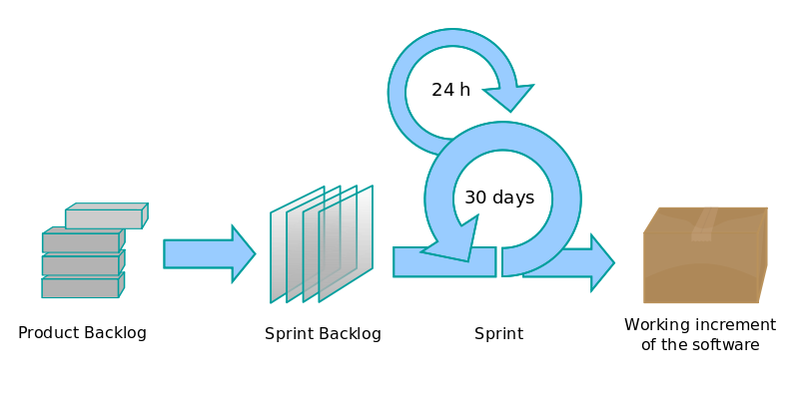
Scrum
Reference: SCRUM Development Process by Ken Scheweber

Slide 24
Software Testing Methodologies
Prashant Joshi

Slide 25
Topic 13.3 : Implications and Issues, Strategies & models

Slide 26
Issues & Implications with SDLCs
Waterfall
V Model
Iterative
Agile

Slide 27
The Waterfall
Requirements Specifications
Preliminary Design
Detailed
Design
Coding
Unit
testing
Integration Testing
System testing

Slide 28
The V-Model
Requirements Specifications
System testing
Preliminary Design
Integration Testing
Detailed
Design
Unit
testing
Coding

Slide 29
Iterative
Arch
Design
Development
Integration & IT
System Test
A View
A Debate

Slide 30
Scrum
Reference: SCRUM Development Process by Ken Scheweber

Slide 31
Software Testing Methodologies
Prashant Joshi

Slide 32
Topic 13.4 : Example and Case

Slide 33
Garage Door
The device controls for opening and closing the door are different for the various product lines. They may include controls from within a home information system. The product architecture for a specific set of controls should be directly derivable from the product line architecture
The processor used in different processes will differ. The product architecture for each specific processor should be directly derivable from the product line architecture
If an obstacle (person or object) is detected by the garage door during descent, it must halt (alternately re-open) within 0.1 second
The garage door opener should be accessible for diagnosis and administration from within the home information system using product specific diagnosis protocol. It should be possible to directly product an architecture that reflects this protocol

Slide 34
Building Lighting Control System
Lighting control system for a apartment complex
Emergency lights are UPS powered
Corridor lights are timed and based on ambient light
Garden and Architectural lights are timed

Slide 35
Garage Door
User Interface
Diagnosis
Raising/Lowering Door
Obstacle detection
Communication Virtual Machine
Sensor/Actuator Virtual Machine
Scheduler That guarantees deadlines

Slide 36
Building Lighting System
User Interface
Local Input
UI
Inputs
Main Control Logic
Communication (Peer 1)
Communication (Peer 2)
Command Receiver and Processor
Configuration
VM for various inputs
Input 1
Input 2
Input 3

Slide 37
Software Testing Methodologies
Prashant Joshi

